Slide 1
连连看with Data Structure
Group | 7
Subject | Data Structure (Final project)
Team leader | (17309003) CHO MANKI
Member | (17309004) KIM SEONGHYEON
 | (17309005) KUM SEONGWON
 | (17309006) MIN SIWAN
Due date | 2018.06.19

Slide 2
Table of contents
Introduction -Team -Project
General Design -Function Module Diagram
Detailed Design -Class Diagram -Flow Chart
Testing
Q&A

Slide 3
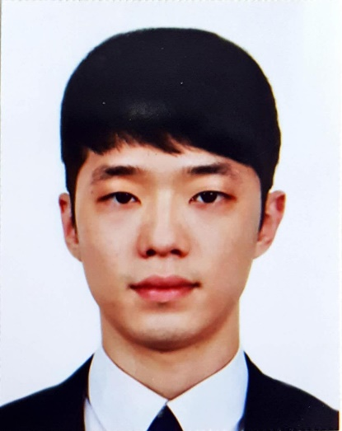
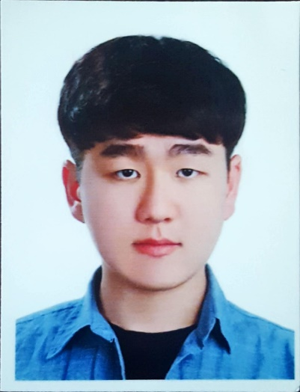
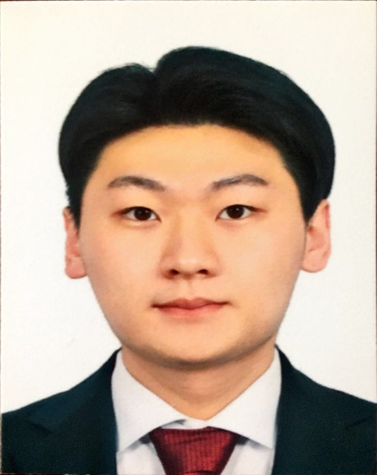

1. Team introduction
 | Part
 | -Team leader -Testing -Requirement Analysis -General design -Support coding
 | Part
 | -Requirement Analysis -Use case diagram -General design -Support coding
 | Part
 | -Project coding -Testing -Function interface design -Requirement Analysis
 | Part
 | -General design -Function interface design -Make a PPT -Support coding -Make a PPT

Slide 4
1. Project introduction
连连看(LLK)
Our team selected and made LLK game. LLK is called 四川省 in Korea. LLK is a game that matches two same pictures within limited time. However, it is only possible to eliminate two picture you selected when two patterns are the same and have path( edge < 4)
Our LLK is made based on Data Structure and C++ MFC
Used Tool : Visual Studio C++ MFC with Data Structure, Photoshop etc. Reference : Google, Naver (Korea web site), C++ MFC textbook etc.
Notes:
우리 팀은 LLK 을 이번 프로젝트로 선정하였습니다. LLK은 두 개의 똑같은 그림을 시간 내에 소거하면 이기게 되는 게임 입니다. (단, 두 그림을 연결하는 경로의 모서리 수가 3, 꼭지점 수가 2 이내 여아만 그림 소거 될 수 있다.)

Slide 5
2. General Design – Function module diagram
连连看
Elimination
Sound
Pause
About
Set difficulty(level)
Help
Rearrangement
Timer
Rank
Start
Notes:
This is our function module diagram. There are 10 function in lianliankan. 기능 읽어

Slide 6
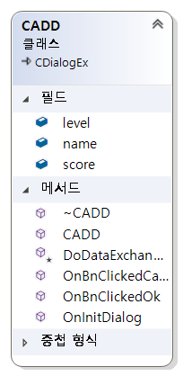
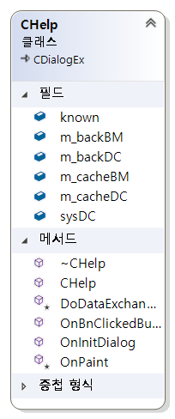
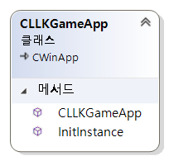
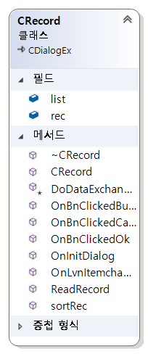
2. General Design – Class diagram
LLKGame header
ADD header
LLKGameDig header
Record header
Help header
Notes:
And it is class diagram to compose lianliankan. ADD, Help, LLKGame header, LLKGameDig, Record.

Slide 7
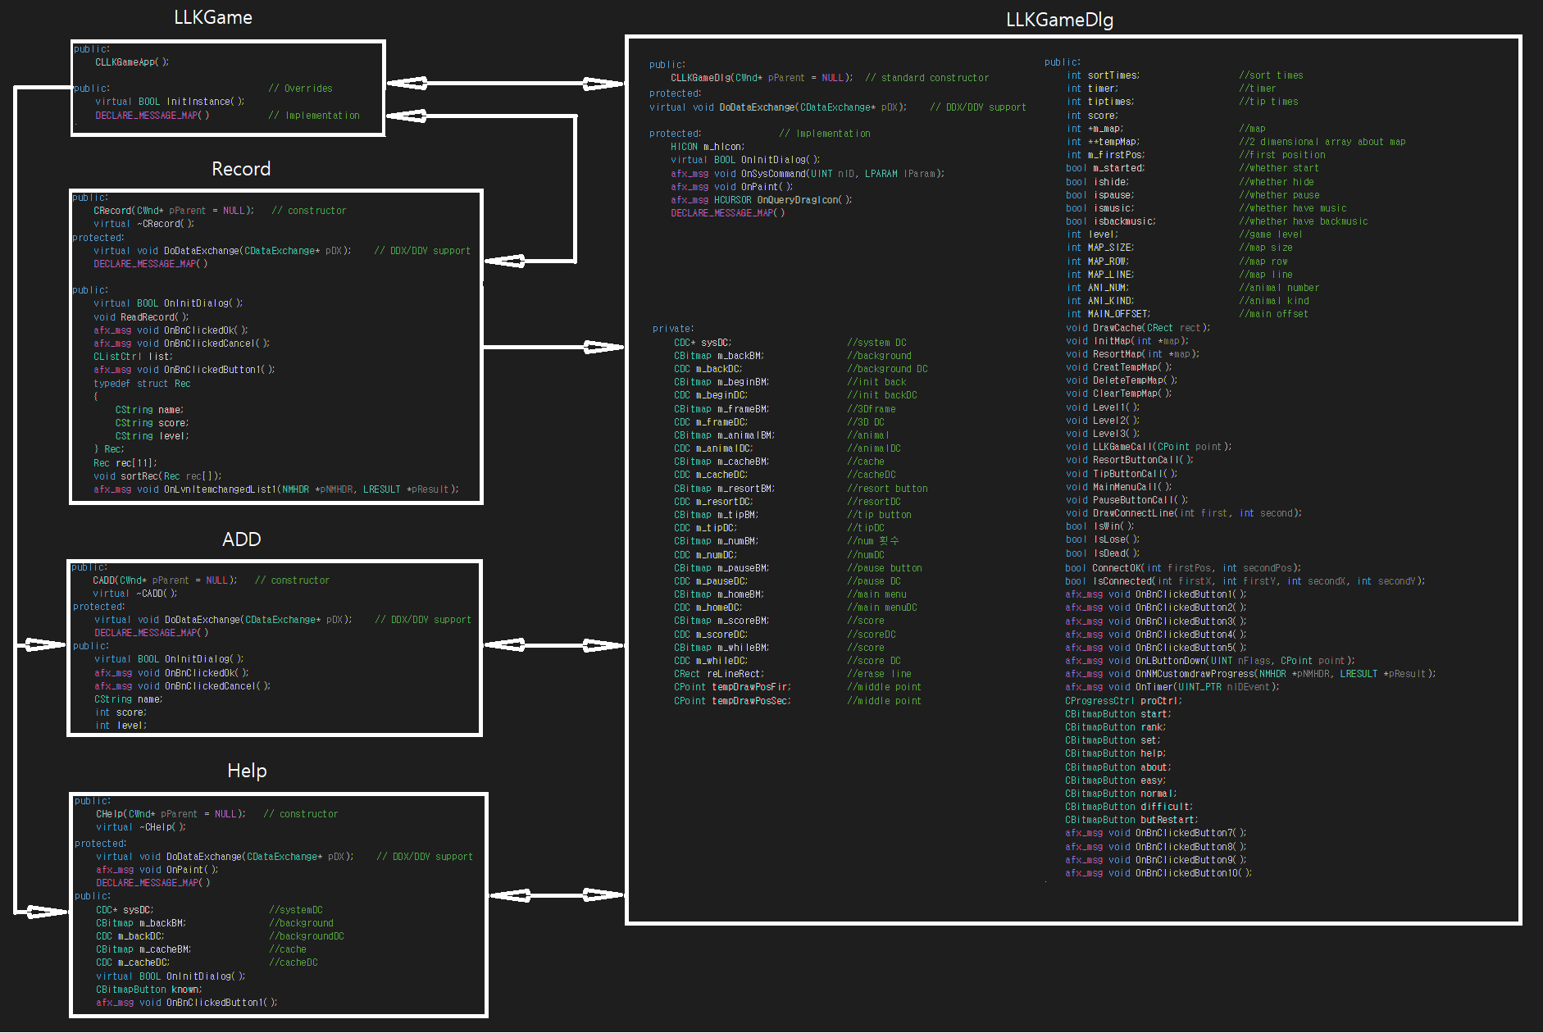

Slide 8
3. Detailed Design – Flow chart(Algorithm)
Start
Countdown
Still have a time
No
Yes
Mouse click
No
Click pattern or not
Yes
Click the second pattern
No
Can be eliminated or not
Yes
Eliminate patterns
Yes
There is more than one pattern
No
You are win
You are lose
Exist
Notes:
As you can see, this is Flow chart. Once Game start, take countdown. And if they have a left time, they can continue the next. Once click mouse button, next, algorithm consider whether the pattern be selected or not. If yes, go next and if no, go into first judgment again. Assume that the previous judgment is YES. And then the user have to choose second pattern. Eliminate the two selected pattern If they can be eliminated. If can not, go first judgment again. If there is no any pattern, you are win but no time and still pattern remained, you are lose.

Slide 9
4. Game interface & function
Main interface & function
Notes:
메인 인터페이스는 START, RANK, HELP, ABOUT, EXIT 로 구성되어있습니다.

Slide 10
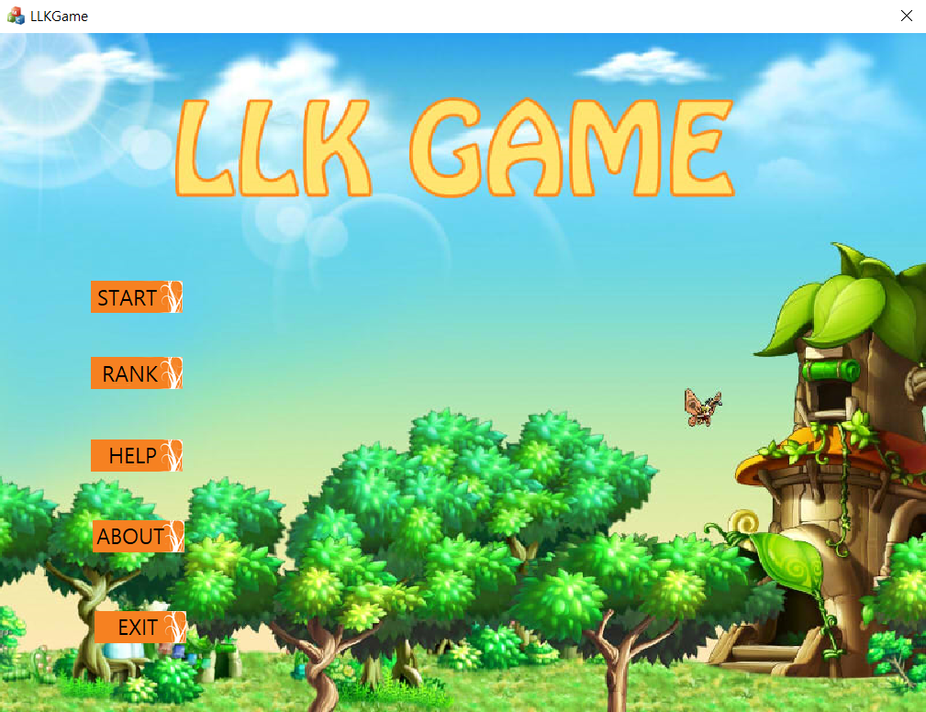
Notes:
This is initial screen. First, Click the start button

Slide 11
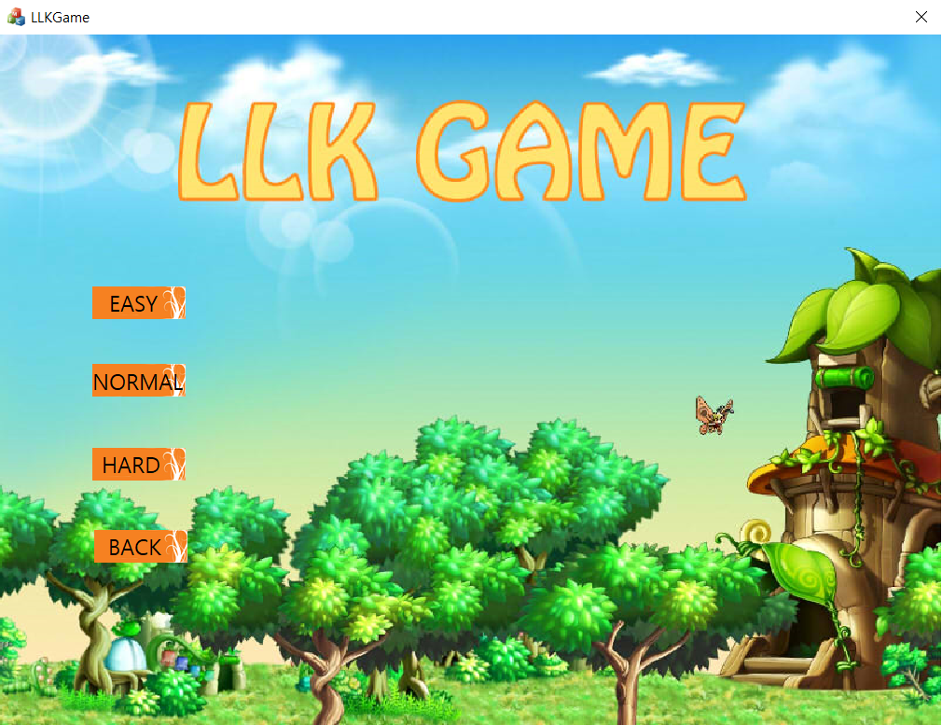
Notes:
Once we click the Start, we can see a screen that can select a game level. In this game, There are three lever – easy, normal, hard. After selecting any level, the Game can be started.

Slide 12
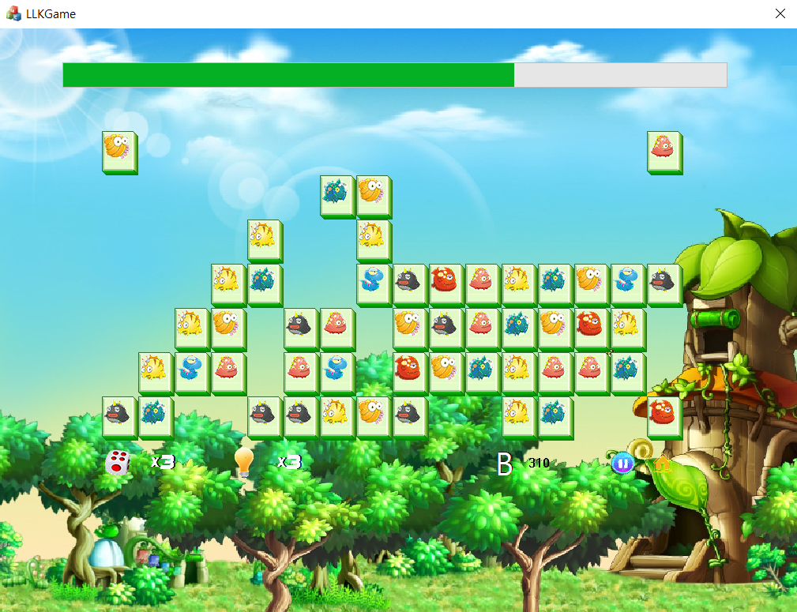


Slide 13
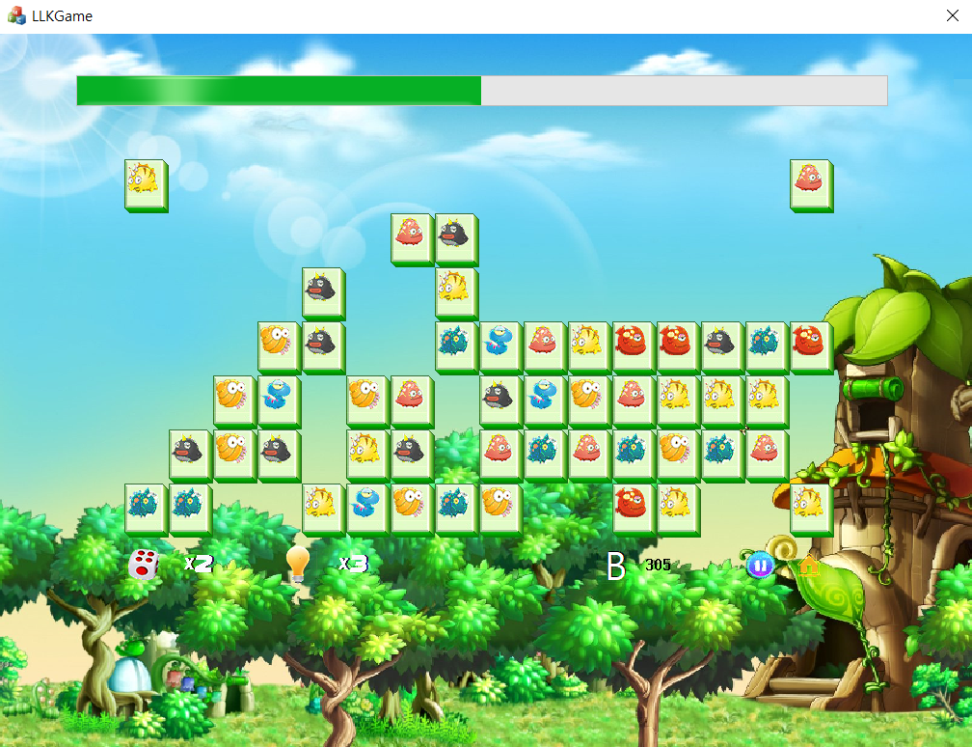

Slide 14
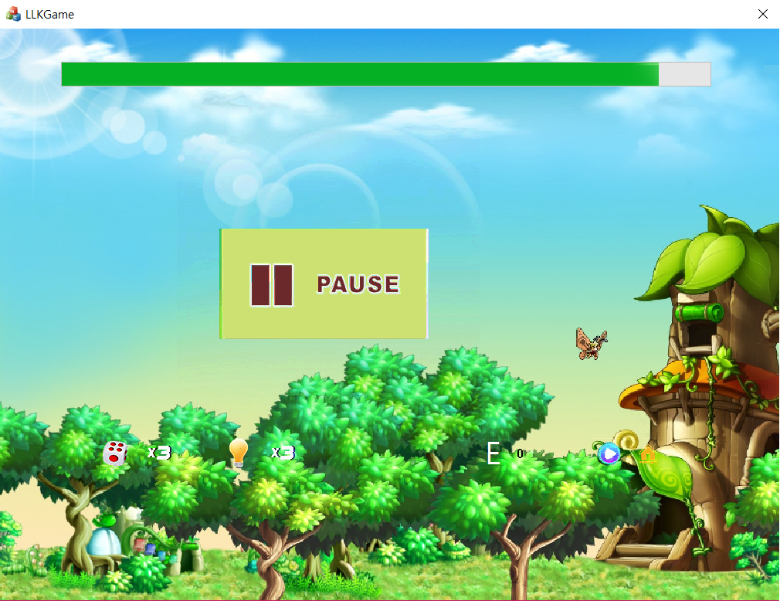

Slide 15
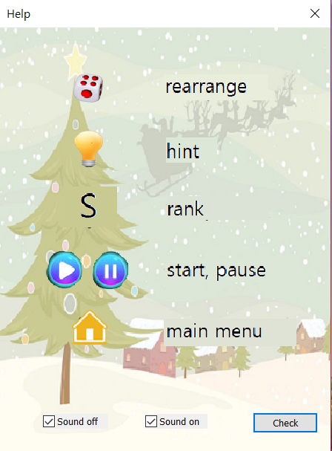
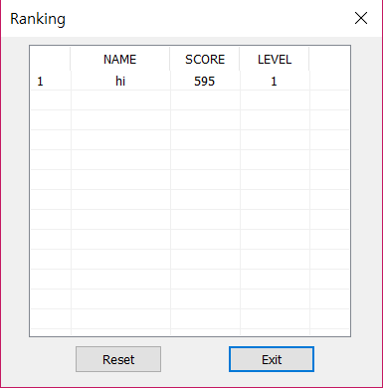
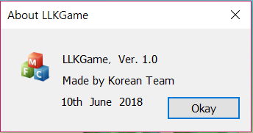
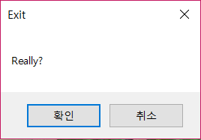

Slide 16
6. Testing
Game Test

Slide 17
7. Q&A
Q&A

Slide 18
谢谢

